Slide 1
N MOHANAPRIYA BE-CSE 730321104027 e-mail id: priyanatarajvpm@gmail.com

Slide 2
Sentiment Analysis on Movie Reviews using Recurrent Neural Networks (RNN)

Slide 3
AGENDA:
Problem Statement
Proposed System/Solution
System Development Approach
Algorithm and Deployment
Result
Conclusion
References

Slide 4
PROBLEM STATEMENT:
To classify movie reviews as positive or negative sentiments, facilitating informed decision-making in the entertainment sector.

Slide 5
PROJECT OVERVIEW:
Using Recurrent Neural Networks (RNNs) on the IMDB dataset, this project aims to classify movie reviews as positive or negative sentiments, providing valuable insights for decision-making in the entertainment industry.

Slide 6
END USERS:
Movie Studio and Production Companies
Streaming Platforms
General Audience
Market Researchers
Advertisers
Content Creators
Social Media Platforms

Slide 7
SOLUTION:
The solution involves developing a sentiment analysis model using Recurrent Neural Networks (RNNs) to accurately classify movie reviews as positive or negative sentiments. By leveraging the IMDB dataset and advanced machine learning techniques, this model offers several key value propositions:
Automated Sentiment Analysis
Insights for Decision-Making
Enhanced User Experience

Slide 8
THE WOW IN YOUR SOLUTION:
Precision and Accuracy
Speed and Efficiency
Actionable Insights
Scalability and Adaptability
Value Creation

Slide 9
MODELLING:
For modeling the sentiment analysis task using Recurrent Neural Networks (RNNs), we'll follow these steps:
Data Preparation
Model Architecture
Compilation
Training
Evaluation
Fine Tuning

Slide 10
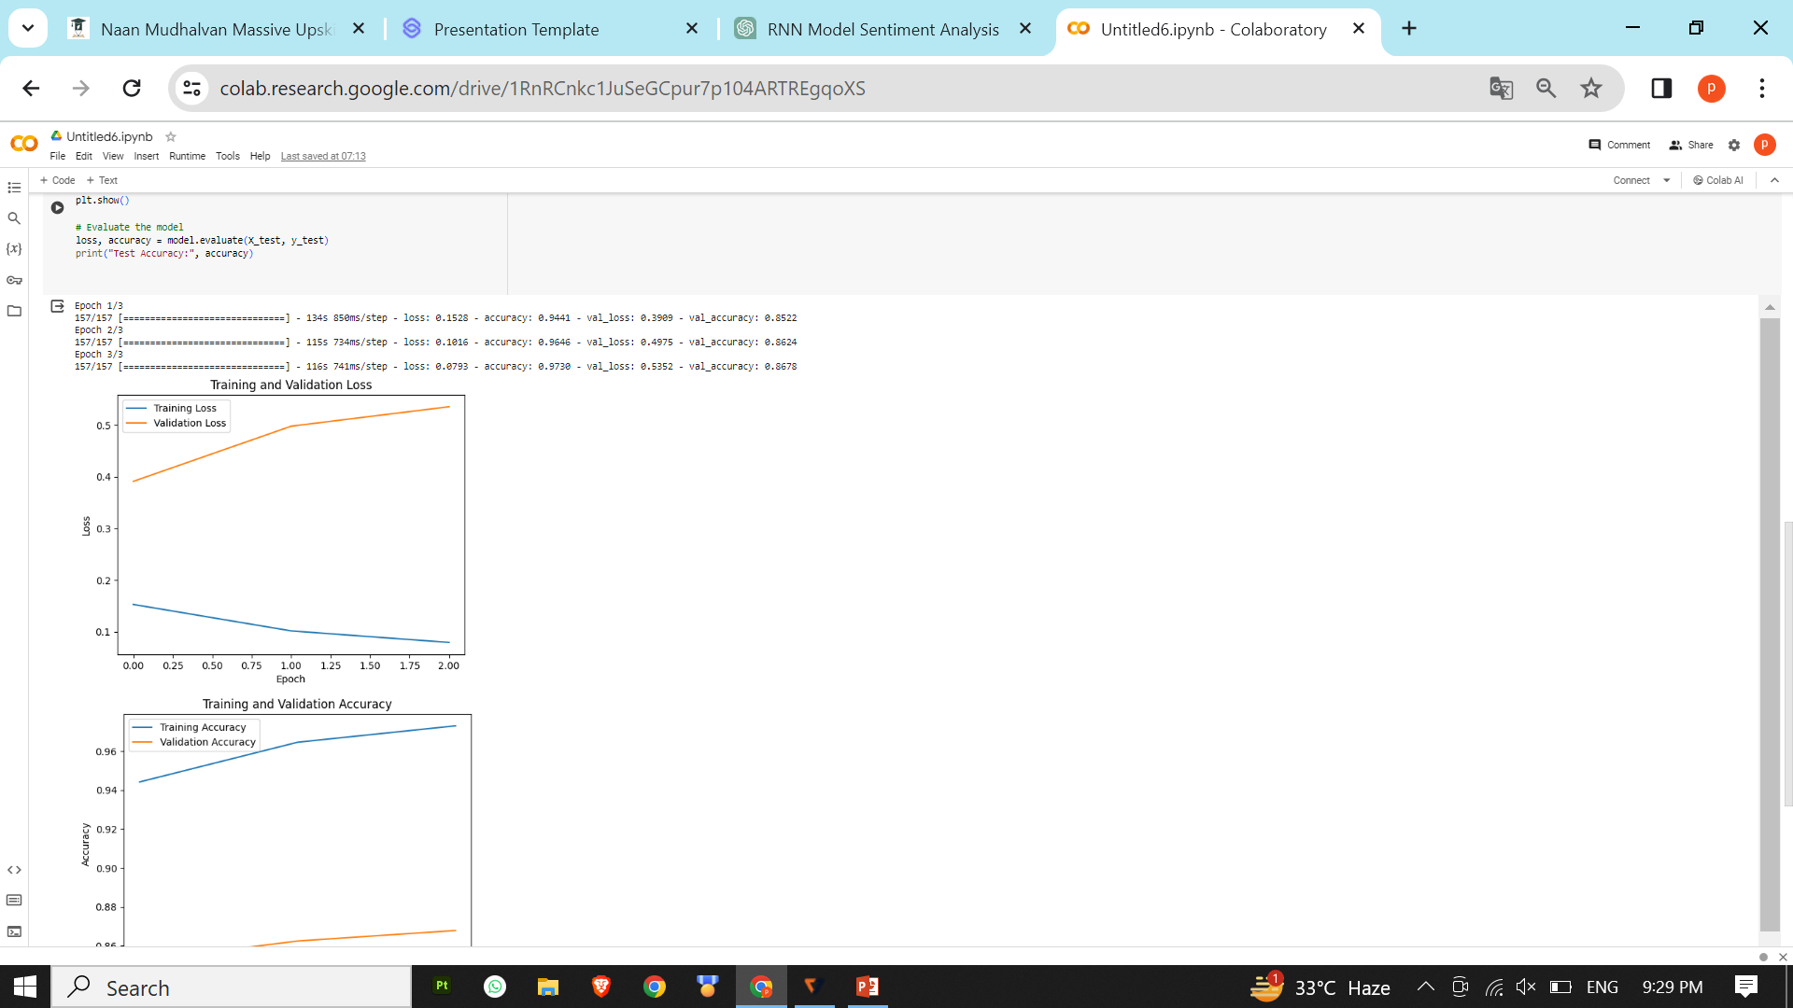
RESULTS:

